Slide 1

Protocol of Reconciliation & Grace Through Separation

Slide 2

The Mediation Team
Bishop Yambasu and Central Conference bishops called the group together in July, 2019 in Chicago
US Bishops
Members of Central Conferences
Progressives, Traditionalists, Centrists representing a variety of groups in the UMC
No budget. All volunteer. No authority.

Slide 3

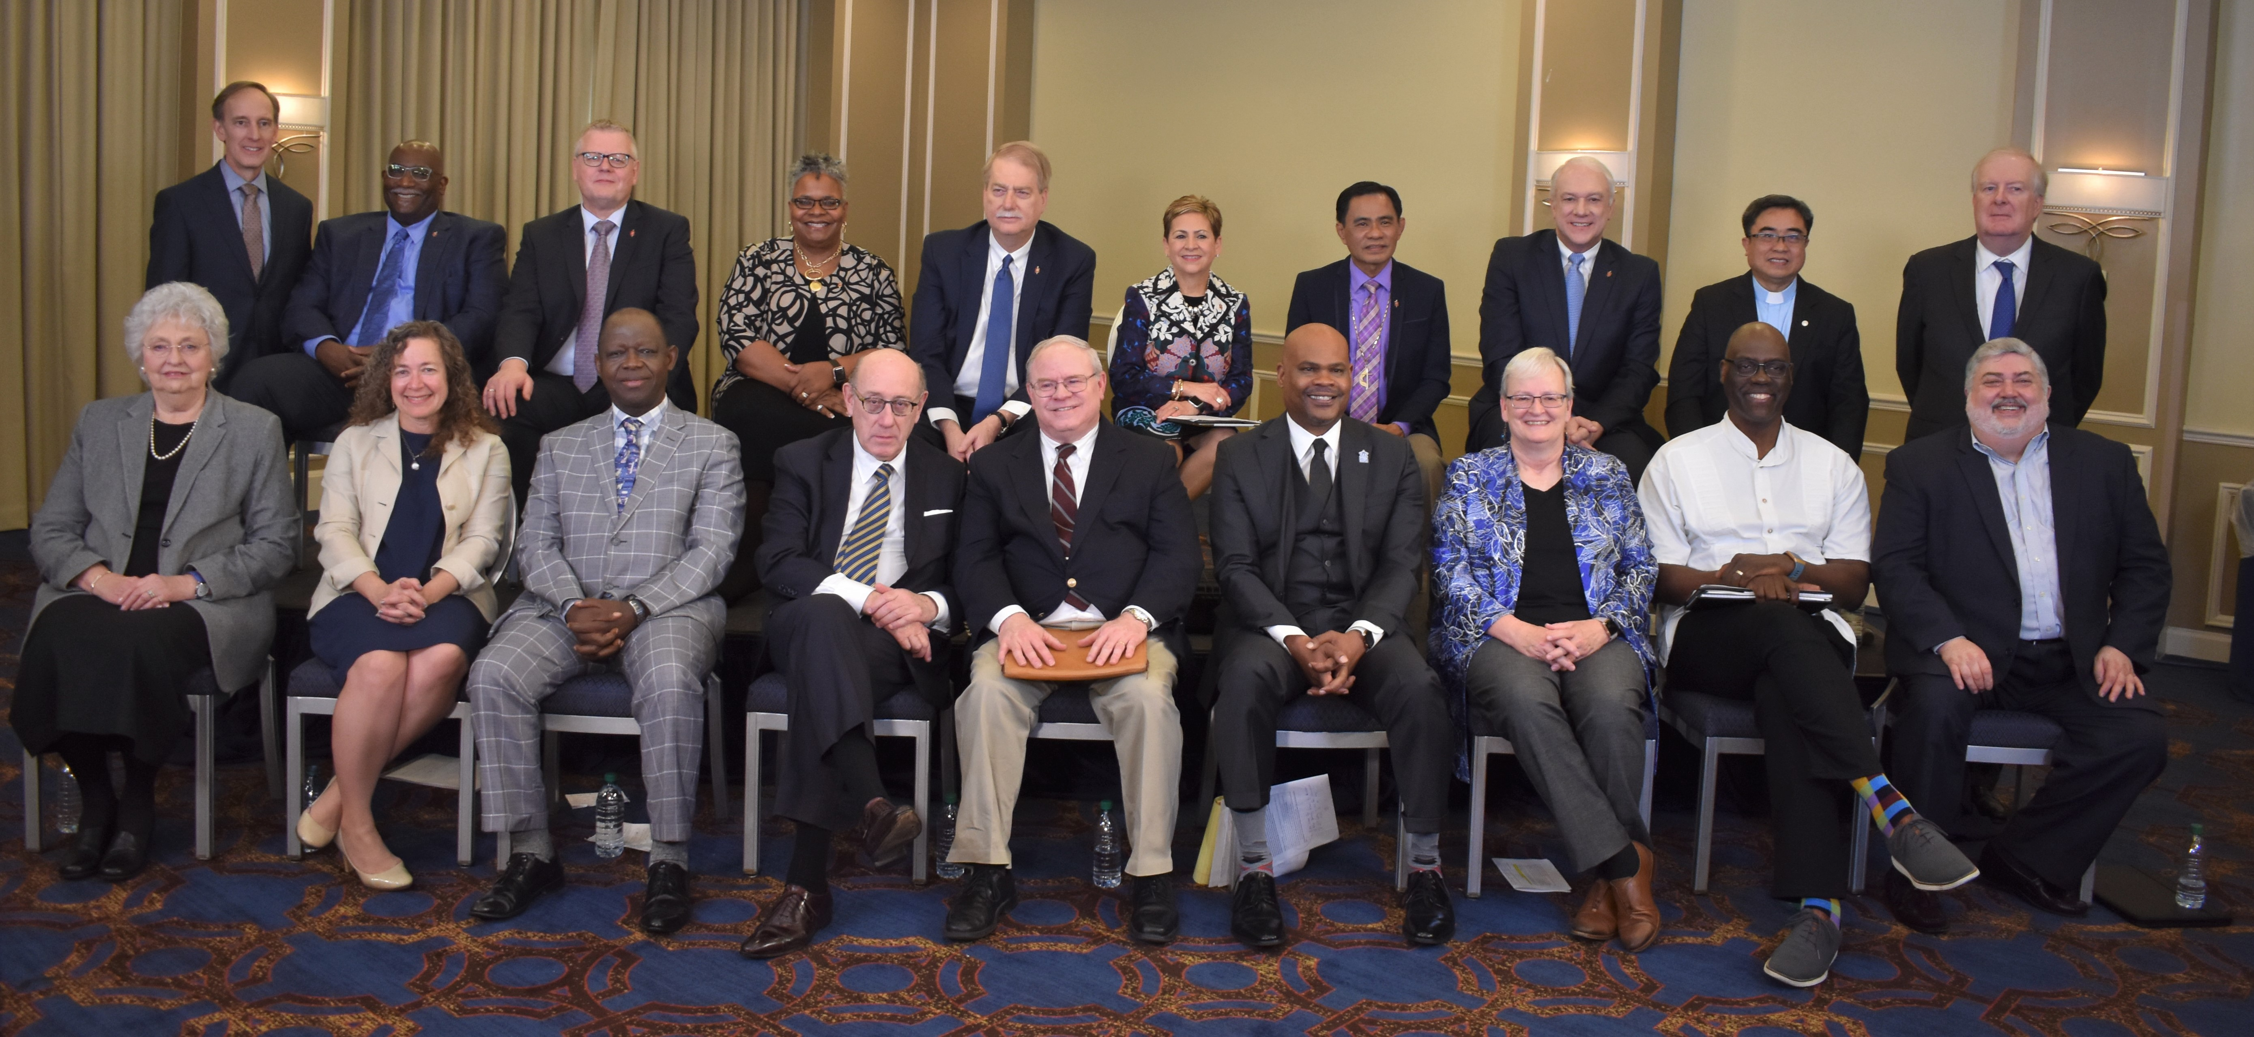

Slide 4
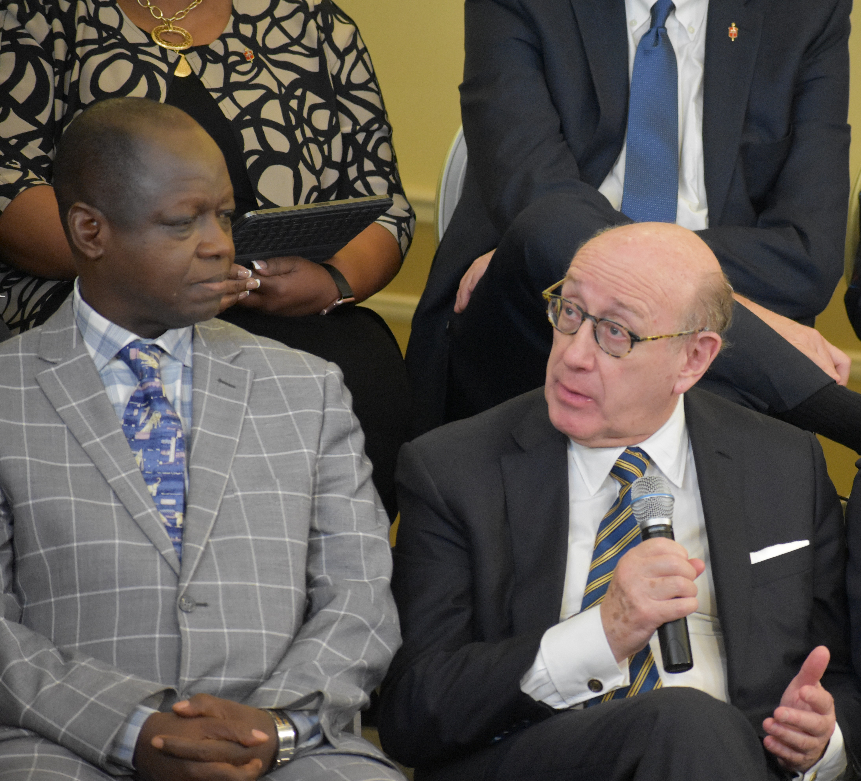
Kenneth Feinberg
Deepwater Horizon, 9-11 Fund, TARP, Boeing, GM, Volkswagen, Hokie Spirit Fund
Pro bono services – Six days of mediation along with meetings between sessions

Slide 5
Commitment to the Protocol
Groups will no longer support the plans they created
Some separation is assumed
Mediation Team will develop legislation to offer the 2020 General Conference
Group will use best efforts to encourage all parties/groups to vote for Protocol legislation
Those who choose to separate agree to bring no claims for additional assets of the UMC in the future

Slide 6
Remaining United Methodist
No Annual Conference must vote
No local church must vote
You are a UMC, and unless your Annual Conference votes to separate, you remain a UMC by simply doing nothing.
If your Annual Conference votes to separate, you can vote to remain in UMC and move to another Annual Conference.

Slide 7
Process and Timeline
Registration of intent of forming new denomination: 5/15/21
Central Conferences may join new denomination: 12/31/21
All AC’s may vote to join new denomination:
  20% support threshold to call for a vote
  Must be supported by 57%
  Affiliation vote must be conducted before: 7/1/21

Slide 8
Process and Timeline
Local churches who want to remain in the UMC if Annual Conference separates
  Church Council: choose simple majority or supermajority vote
  Vote taken at Church Conference

Slide 9
Financial Agreement
Local Church joining a Methodist denomination (pursuant to the Protocol)
  Retains its assets and liabilities
  Annual Conference will not exercise its
  trust clause
  Expected to maintain connectional responsibilities prior to departure

Slide 10
Annual Conferences
Retain all property if they join Methodist denomination pursuant to the Protocol

Slide 11
Financial Agreements
Traditional Methodist denomination $25M
Other Methodist denominations $2M
If more than one Traditional Methodist denomination would be registered, $25M would be split amongst those entities

Slide 12
Financial Agreements
Earmark for Ministries to Asian, Black, Hispanic-Latino, Native American and Pacific Islander Communities and Africa University $39M over two quadrennia

Slide 13
Moratorium
Bishops asked to place all administrative and judicial processes addressing restrictions in Book of Discipline related to self-avowed practicing homosexuals or same-sex weddings in abeyance
  January 1, 2020 through adjournment of first conference of the post-separation UMC

Slide 14

Divorce or Reconciliation?
LOG IN
LOG IN
“Can this church be saved? Split on LGBTQ issues, United Methodists consider divorce”
“The Methodists, the mediator and the divorce plan”

Slide 15
How does this all get done?
Section VI, page 6 of Protocol offers a process to help all parties receive what they need in 2020
This section is being rewritten to identify a process that will work with the Book of Discipline
It will require a high level of coordination and cooperation

Slide 16
What’s Next?
Draft Legislation by Mediation Team
Find a way to get legislation to the General Conference delegates
  Annual Conference passes legislation without changes
  Motion to suspend the rules
  Motion to Substitute

